Slide 1


SelectFuzz: Efficient Directed Fuzzing
with Selective Path Exploration
Advanced Computer Security
Nov 21, 2023
20225398 Xiyana Figuera

Slide 2

Contents
Background and Motivation
Major Challenges
SelectFuzz
Evaluation
Limitations

Slide 3
Background
General coverage-guided fuzzers
Directed fuzzers

Slide 4
Background
General coverage-guided fuzzers → All code
Directed fuzzers

Slide 5
Background
General coverage-guided fuzzers → All code
Directed fuzzers → Specific code location

Slide 6
Background
General coverage-guided fuzzers → All code
Directed fuzzers → Specific code location
Existing directed fuzzers
Built upon AFL
Path exploration strategy

Slide 7
Background
General coverage-guided fuzzers → All code
Directed fuzzers → Specific code location
Existing directed fuzzers
Built upon AFL
Path exploration strategy → Favours new coverage

Slide 8
Background
General coverage-guided fuzzers → All code
Directed fuzzers → Specific code location
Existing directed fuzzers
Built upon AFL
Path exploration strategy → Favours new coverage
Executions of most (e.g 65.1%) fuzzing inputs do not help reach the targets

Slide 9
Background
General coverage-guided fuzzers → All code
Directed fuzzers → Specific code location
Existing directed fuzzers
Built upon AFL
Path exploration strategy → Favours new coverage
Executions of most (e.g 65.1%) fuzzing inputs do not help reach the targets
No attempt to distinguish irrelevant inputs

Slide 10
Motivation
What affects fuzzer efficiency?

Slide 11
Motivation
What affects fuzzer efficiency?
Fuzzer efficiency = Right allocation of its energy

Slide 12
Motivation
What affects fuzzer efficiency?
Fuzzer efficiency = Right allocation of its energy
Where should we allocate this energy?

Slide 13
Motivation
What affects fuzzer efficiency?
Fuzzer efficiency = Right allocation of its energy
Where should we allocate this energy?
Code does not help in triggering vulnerabilities = Irrelevant code

Slide 14

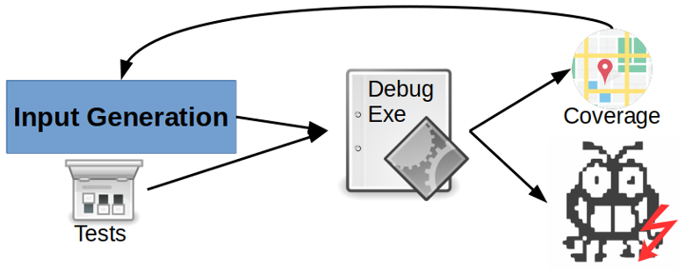
Background
Two directions

Slide 15
Background
Two directions
High-quality inputs (e.g., leveraging symbolic executions)

Slide 16
Background
Two directions
High-quality inputs (e.g., leveraging symbolic executions)
Inputs of interest

Slide 17
Background
Two directions
High-quality inputs (e.g., leveraging symbolic executions)
Inputs of interest ← SelectFuzz

Slide 18
Background: Identify the inputs of interest
Distance-based Input Prioritization
Input Reachability Analysis

Slide 19
Background: Identify the inputs of interest
Distance-based Input Prioritization
Distance metrics (e.g AFLGo)
Input Reachability Analysis

Slide 20
Background: Identify the inputs of interest
Distance-based Input Prioritization
Distance metrics (e.g AFLGo) → Smaller distances
Input Reachability Analysis

Slide 21
Background: Identify the inputs of interest
Distance-based Input Prioritization
Distance metrics (e.g AFLGo) → Smaller distances
Not much improvement over AFLGo (e.g Windranger 44%)
Effectiveness not guaranteed
Some vulnerabilities are hidden deeply in the longer paths
Less energy to irrelevant
Input Reachability Analysis

Slide 22
Background: Identify the inputs of interest
Distance-based Input Prioritization
Distance metrics (e.g AFLGo) → Smaller distances
Not much improvement over AFLGo (e.g Windranger 44%)
Effectiveness not guaranteed
Some vulnerabilities are hidden deeply in the longer paths
Less energy to irrelevant → Total irrelevant >>> total relevant
Input Reachability Analysis

Slide 23
Background: Identify the inputs of interest
Distance-based Input Prioritization
Distance metrics (e.g AFLGo) → Smaller distances
Not much improvement over AFLGo (e.g Windranger 44%)
Effectiveness not guaranteed
Some vulnerabilities are hidden deeply in the longer paths
Less energy to irrelevant → Total irrelevant >>> total relevant
Input Reachability Analysis
Identifying the unreachable inputs

Slide 24
Background: Identify the inputs of interest
Distance-based Input Prioritization
Distance metrics (e.g AFLGo) → Smaller distances
Not much improvement over AFLGo (e.g Windranger 44%)
Effectiveness not guaranteed
Some vulnerabilities are hidden deeply in the longer paths
Less energy to irrelevant → Total irrelevant >>> total relevant
Input Reachability Analysis
Identifying the unreachable inputs
Still Energy waste

Slide 25
Background: Identify the inputs of interest
Distance-based Input Prioritization
Distance metrics (e.g AFLGo) → Smaller distances
Not much improvement over AFLGo (e.g Windranger 44%)
Effectiveness not guaranteed
Some vulnerabilities are hidden deeply in the longer paths
Less energy to irrelevant → Total irrelevant >>> total relevant
Input Reachability Analysis
Identifying the unreachable inputs
Still Energy waste → Reachable yet irrelevant

Slide 26
Motivation
Beacon (SOTA)
Path pruning method
Number of irrelevant inputs
Terminates execution of unreachable paths

Slide 27
Motivation
Beacon (SOTA)
Path pruning method
Number of irrelevant inputs → Decreases
Terminates execution of unreachable paths

Slide 28
Motivation
Beacon (SOTA)
Path pruning method
Number of irrelevant inputs → Decreases
Terminates execution of unreachable paths
Large proportion (i.e., 87.67%) of reachable code in real-world programs is actually irrelevant

Slide 29
Motivation
Beacon (SOTA)
Path pruning method
Number of irrelevant inputs → Decreases
Terminates execution of unreachable paths
Large proportion (i.e., 87.67%) of reachable code in real-world programs is actually irrelevant
Wastes much energy on reachable irrelevant code

Slide 30
Challenges
How to precisely identify the relevant code a directed fuzzer should explore?
How to exclude the irrelevant code from directed fuzzing?

Slide 31
Challenges
How to precisely identify the relevant code a directed fuzzer should explore?
No formal definition
Not trivial
If misled to explore irrelevant code
How to exclude the irrelevant code from directed fuzzing?

Slide 32
Challenges
How to precisely identify the relevant code a directed fuzzer should explore?
No formal definition
Not trivial
If misled to explore irrelevant code → low efficiency
How to exclude the irrelevant code from directed fuzzing?

Slide 33
Challenges
How to precisely identify the relevant code a directed fuzzer should explore?
No formal definition
Not trivial
If misled to explore irrelevant code → low efficiency
How to exclude the irrelevant code from directed fuzzing?
Early termination

Slide 34
Challenges
How to precisely identify the relevant code a directed fuzzer should explore?
No formal definition
Not trivial
If misled to explore irrelevant code → low efficiency
How to exclude the irrelevant code from directed fuzzing?
Early termination → waste energy in reachable irrelevant code

Slide 35
Challenges
How to precisely identify the relevant code a directed fuzzer should explore?
No formal definition
Not trivial
If misled to explore irrelevant code → low efficiency
How to exclude the irrelevant code from directed fuzzing?
Early termination → waste energy in reachable irrelevant code
Remove irrelevant code (e.g Software debloating)

Slide 36
Challenges
How to precisely identify the relevant code a directed fuzzer should explore?
No formal definition
Not trivial
If misled to explore irrelevant code → low efficiency
How to exclude the irrelevant code from directed fuzzing?
Early termination → waste energy in reachable irrelevant code
Remove irrelevant code (e.g Software debloating)
Runtime errors

Slide 37
Challenges
How to precisely identify the relevant code a directed fuzzer should explore?
No formal definition
Not trivial
If misled to explore irrelevant code → low efficiency
How to exclude the irrelevant code from directed fuzzing?
Early termination → waste energy in reachable irrelevant code
Remove irrelevant code (e.g Software debloating)
Runtime errors
Inputs might not apply to the original program

Slide 38
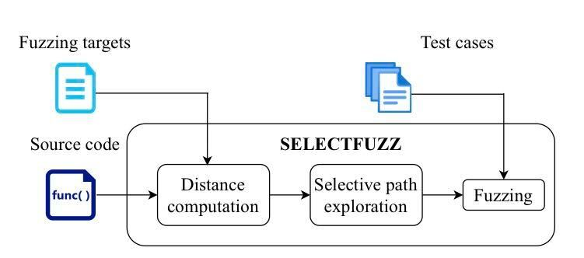
SelectFuzz
Directed fuzzer
Statically identifies relevant code with respect to the targets.
Improved input prioritization mechanism

Slide 39
SelectFuzz
Directed fuzzer
Statically identifies relevant code with respect to the targets.
Improved input prioritization mechanism → new distance metric

Slide 40
SelectFuzz
Distance metric
Prior works
SelectFuzz

Slide 41
SelectFuzz
Distance metric
Prior works → shortest paths
SelectFuzz

Slide 42
SelectFuzz
Distance metric
Prior works → shortest paths
SelectFuzz → more likely Inputs

Slide 43
SelectFuzz
Selective path exploration
Applies coverage and distance instrumentations to only the relevant code

Slide 44
SelectFuzz
Selective path exploration
Applies coverage and distance instrumentations to only the relevant code
Instruments only the relevant code

Slide 45
SelectFuzz
How to precisely identify the relevant code a directed fuzzer should explore?

Slide 46
SelectFuzz
How to precisely identify the relevant code a directed fuzzer should explore?
Control-flow and data-flow conditions

Slide 47
SelectFuzz
How to precisely identify the relevant code a directed fuzzer should explore?
Control-flow and data-flow conditions
Path-divergent code (control-dependent, Exploration)
Data-dependent code (exploitation)

Slide 48
SelectFuzz
How to precisely identify the relevant code a directed fuzzer should explore?
Control-flow and data-flow conditions
Path-divergent code (control-dependent, Exploration)
Important feedback for efficiently reaching the target code
Data-dependent code (exploitation)

Slide 49
SelectFuzz
How to precisely identify the relevant code a directed fuzzer should explore?
Control-flow and data-flow conditions
Path-divergent code (control-dependent, Exploration)
Important feedback for efficiently reaching the target code
Data-dependent code (exploitation)
Influences the value of critical variables in the target code

Slide 50
SelectFuzz
How to exclude the irrelevant code from directed fuzzing?

Slide 51
SelectFuzz
How to exclude the irrelevant code from directed fuzzing?
Selectively instrument only relevant code

Slide 52
SelectFuzz
How to exclude the irrelevant code from directed fuzzing?
Selectively instrument only relevant code
Issue: Execution of numerous irrelevant code

Slide 53
SelectFuzz
How to exclude the irrelevant code from directed fuzzing?
Selectively instrument only relevant code
Issue: Execution of numerous irrelevant code
Solution: Feedback only from relevant code

Slide 54
SelectFuzz
How to exclude the irrelevant code from directed fuzzing?
Selectively instrument only relevant code
Issue: Execution of numerous irrelevant code
Solution: Feedback only from relevant code
No feedback

Slide 55
SelectFuzz
How to exclude the irrelevant code from directed fuzzing?
Selectively instrument only relevant code
Issue: Execution of numerous irrelevant code
Solution: Feedback only from relevant code
No feedback
No favour

Slide 56
SelectFuzz
How to exclude the irrelevant code from directed fuzzing?
Selectively instrument only relevant code
Issue: Execution of numerous irrelevant code
Solution: Feedback only from relevant code
No feedback
No favour
Most energy allocated to relevant code
Avoids potential runtime errors (e.g in debloating-based)
Avoids runtime instrumentation overhead → AFLbased incur over 30%

Slide 57
SelectFuzz
Selective path exploration
Inter-procedural control-flow and data-flow analysis
Identification and instrumentation of only relevant code

Slide 58
SelectFuzz
Selective path exploration
Inter-procedural control-flow and data-flow analysis
Identification and instrumentation of only relevant code
Assigns mutation energy based on
Runtime
Relevant code coverage
Input distance feedback

Slide 59
SelectFuzz
Selective path exploration
Inter-procedural control-flow and data-flow analysis
Identification and instrumentation of only relevant code
Assigns mutation energy based on
Runtime → high-quality runtime feedback
Relevant code coverage
Input distance feedback

Slide 60
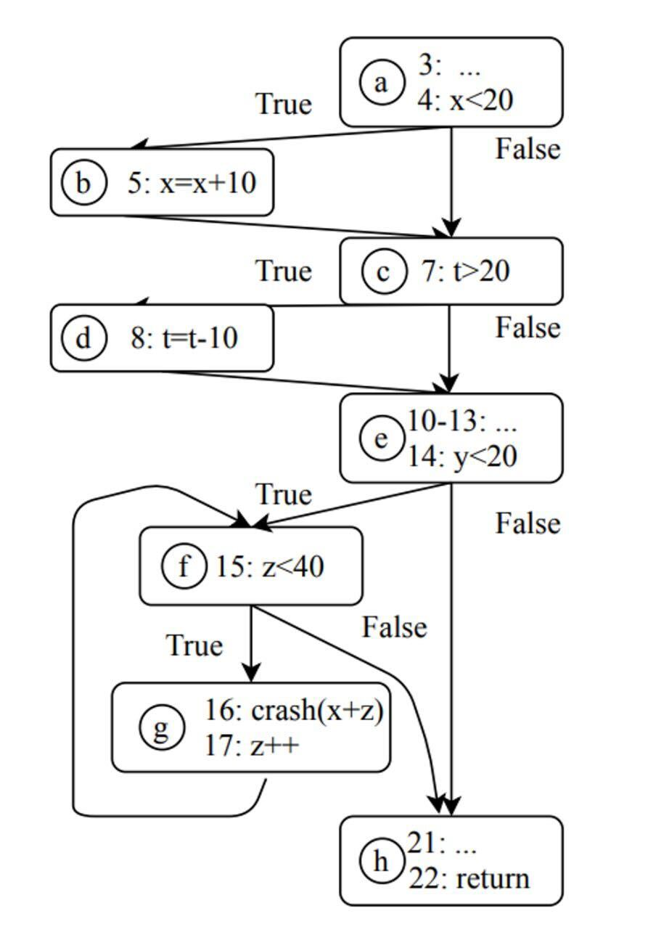
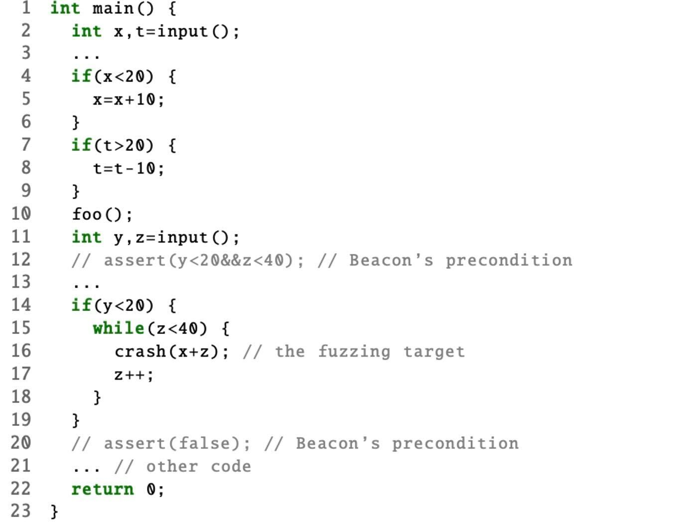
SelectFuzz: Relevant code conditions

Slide 61
SelectFuzz: Relevant code conditions
Any path reaches

Slide 62
SelectFuzz: Relevant code conditions
Any path reaches → Irrelevant code

Slide 63
SelectFuzz: Relevant code conditions
Determines if execution can reach

Slide 64
SelectFuzz: Relevant code conditions
Determines if execution can reach → Relevant code

Slide 65
SelectFuzz
How to precisely identify the relevant code a directed fuzzer should explore?
Control-flow and data-flow conditions
Path-divergent code (control-dependent, Exploration)
Important feedback for efficiently reaching the target code
In the last intersection block of a reachable path and unreachable path
Data-dependent code (exploitation)
Influences the value of critical variables in the target code

Slide 66
SelectFuzz: Relevant code conditions
Indirectly affects path divergent code

Slide 67
SelectFuzz: Relevant code conditions
Indirectly affects path divergent code → Irrelevant code

Slide 68
SelectFuzz: Relevant code conditions
Indirectly affects path divergent code → Irrelevant code
visited anyway

Slide 69
SelectFuzz: Relevant code conditions
Execution helps exploit vulnerability

Slide 70
SelectFuzz: Relevant code conditions
Execution helps exploit vulnerability → data-flow

Slide 71
SelectFuzz
How to precisely identify the relevant code a directed fuzzer should explore?
Control-flow and data-flow conditions
Path-divergent code (control-dependent, Exploration)
Important feedback for efficiently reaching the target code
In the last intersection block of a reachable path and unreachable path
Data-dependent code (exploitation)
Influences the value of critical variables in the target code
Might be Irrelevant for control-flow but can trigger vulnerabilities

Slide 72
SelectFuzz: Selective path exploration
Different Instrumentation strategy
Input Prioritization
Power Scheduling

Slide 73
SelectFuzz: Selective path exploration
Different Instrumentation strategy
Input Prioritization
Inputs that cover new paths
Inputs that increase the hit count
Power Scheduling

Slide 74
SelectFuzz: Selective path exploration
Different Instrumentation strategy
Input Prioritization
Inputs that cover new paths
Inputs that increase the hit count
Does not always find relevant inputs
Power Scheduling

Slide 75
SelectFuzz: Selective path exploration
Different Instrumentation strategy
Input Prioritization
Inputs that cover new paths
Inputs that increase the hit count
Does not always find relevant inputs
Power Scheduling
Mutate irrelevant inputs with smaller input distances

Slide 76
SelectFuzz: Selective path exploration
Different Instrumentation strategy
Input Prioritization
Inputs that cover new paths
Inputs that increase the hit count
Does not always find relevant inputs
Power Scheduling
Annealing-based power scheduling (AFLGo)
Not instrumented code is not included when computing input distance which might affect the power scheduling
Mutate irrelevant inputs with smaller input distances

Slide 77
SelectFuzz: Distance metric
Distance metric
Inter-procedural block distances- including other functions
Probability of reaching target code
Advantages
All possible paths
Cross-function distance

Slide 78
SelectFuzz: Distance metric
Input distance
Prior works
SelectFuzz

Slide 79
SelectFuzz: Distance metric
Input distance
Prior works → Average block distance
SelectFuzz

Slide 80
SelectFuzz: Distance metric
Input distance
Prior works → Average block distance
SelectFuzz → Shortest block distance

Slide 81
SelectFuzz: Distance metric
Input distance
Prior works → Average block distance
SelectFuzz → Shortest block distance
How close the execution is to the target

Slide 82
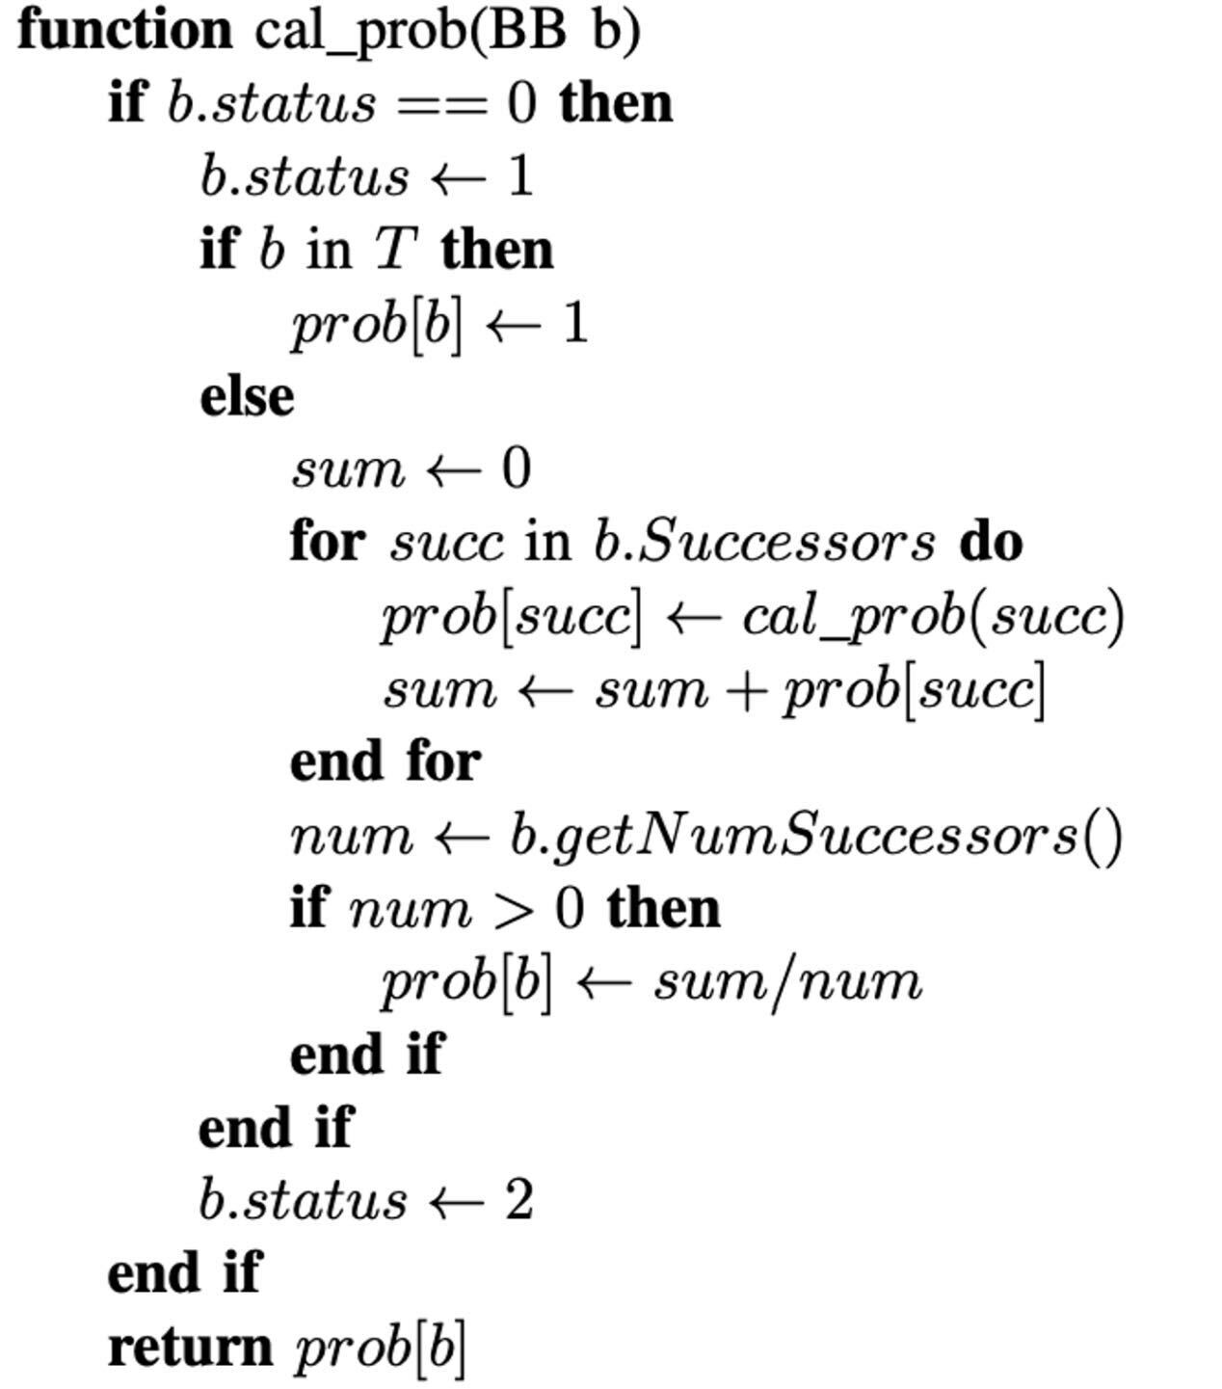
SelectFuzz: Block distance
Reaching probability P_{b} of a basic block b
Variables
BB: Basic Block
T: Target location
Labels
0: Initial
1: Distance is being computed
2: Distance has been computed

Slide 83
SelectFuzz: Block distance
BB in T
Probability set to 100%

Slide 84
SelectFuzz: Block distance
BB in T
Probability set to 100%
BB not in T
Recursion
Avg of reaching prob. of all its successor blocks

Slide 85
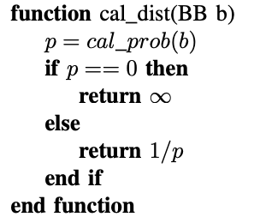
SelectFuzz: Block distance
Block Distance:
Inverse of the computed probability

Slide 86
SelectFuzz: Block distance
Block Distance:
Inverse of the computed probability
Smaller probability → Bigger Distance

Slide 87
SelectFuzz: Distance metric
Considerations on conditional expression complexity
Depend on logical expressions and corresponding inputs
Not considered

Slide 88
SelectFuzz: Distance metric
Considerations on conditional expression complexity
Depend on logical expressions and corresponding inputs
Not considered
Unroll loop bodies (e.g Treat as if statements)

Slide 89
SelectFuzz: Distance metric
Considerations on conditional expression complexity
Depend on logical expressions and corresponding inputs
Not considered
Unroll loop bodies (e.g Treat as if statements)
Symbolic execution could help (future work)

Slide 90
SelectFuzz: Distance metric
Considerations on conditional expression complexity
Depend on logical expressions and corresponding inputs
Not considered
Unroll loop bodies (e.g Treat as if statements)
Symbolic execution could help (future work)
Cross-function block distances
ICFG
False positives

Slide 91
SelectFuzz: Distance metric
Considerations on conditional expression complexity
Depend on logical expressions and corresponding inputs
Not considered
Unroll loop bodies (e.g Treat as if statements)
Symbolic execution could help (future work)
Cross-function block distances
ICFG
False positives → distance is bigger

Slide 92
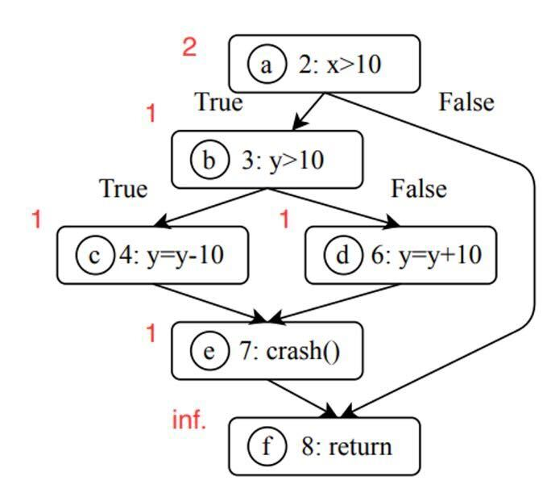
SelectFuzz: Distance metric example (S1)
Avg of reaching prob. of all its successor blocks
P_{a} = ( P_{b} + P_{f} ) / 2

Slide 93
SelectFuzz: Distance metric example (S1)
Avg of reaching prob. of all its successor blocks
P_{a} = ( P_{b} + P_{f} ) / 2
P_{f} = 0

Slide 94
SelectFuzz: Distance metric example (S1)
Avg of reaching prob. of all its successor blocks
P_{a} = ( P_{b} + P_{f} ) / 2
P_{f} = 0
P_{b} = ( P_{c} + P_{d} ) / 2

Slide 95
SelectFuzz: Distance metric example (S1)
Avg of reaching prob. of all its successor blocks
P_{a} = ( P_{b} + P_{f} ) / 2
P_{f} = 0
P_{b} = ( P_{c} + P_{d} ) / 2 = ( 1+1 ) / 2 = 1

Slide 96
SelectFuzz: Distance metric example (S1)
Avg of reaching prob. of all its successor blocks
P_{a} = ( P_{b} + P_{f} ) / 2
P_{f} = 0
P_{b} = ( P_{c} + P_{d} ) / 2 = ( 1+1 ) / 2 = 1
P_{a} = ( 1 + 0 ) / 2 = 1/2

Slide 97
SelectFuzz: Distance metric example (S1)
Distance is the inverse of Probability
P_{a} = 1/2
d_{bb}(a, T) = 1 / (½) = 2

Slide 98
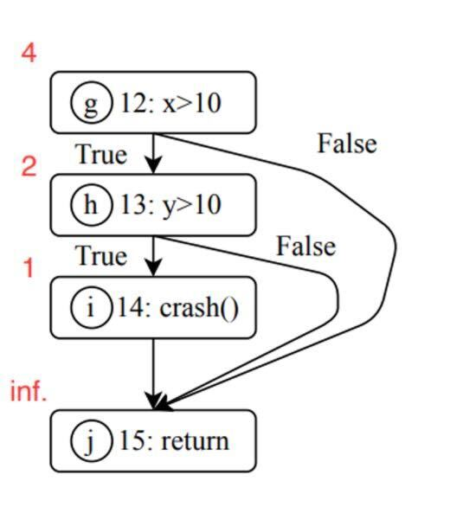
SelectFuzz: Distance metric example (S2)
P_{g} = ( P_{h} + P_{j} ) / 2

Slide 99
SelectFuzz: Distance metric example (S2)
P_{g} = ( P_{h} + P_{j} ) / 2
P_{j} = 0

Slide 100
SelectFuzz: Distance metric example (S2)
P_{g} = ( P_{h} + P_{j} ) / 2
P_{j} = 0
P_{h} = ( P_{i} + P_{j} ) / 2

Slide 101
SelectFuzz: Distance metric example (S2)
P_{g} = ( P_{h} + P_{j} ) / 2
P_{j} = 0
P_{h} = ( P_{i} + P_{j} ) / 2 = ( 1 + 0 ) /2 = 1/2

Slide 102
SelectFuzz: Distance metric example (S2)
P_{g} = ( P_{h} + P_{j} ) / 2
P_{j} = 0
P_{h} = ( P_{i} + P_{j} ) / 2 = ( 1 + 0 ) /2 = 1/2
P_{g} = ( ½ + 0 ) / 2 = 1/4

Slide 103
SelectFuzz: Distance metric example (S2)
P_{g} = ( P_{h} + P_{j} ) / 2
P_{j} = 0
P_{h} = ( P_{i} + P_{j} ) / 2 = ( 1 + 0 ) /2 = 1/2
P_{g} = ( ½ + 0 ) / 2 = 1/4
d_{bb}(g, T) = 1 / ( ¼ ) = 4

Slide 104
SelectFuzz: Distance metric example
AFLGo would priorize S2
S1 d(a, T) = 3
S2 d(g, T) = 2
Selectfuzz allocates more energy to S1
S1 d_{bb}(a, T) = 2
S2 d_{bb}(g, T) = 4

Slide 105

SelectFuzz
Experiments

Slide 106
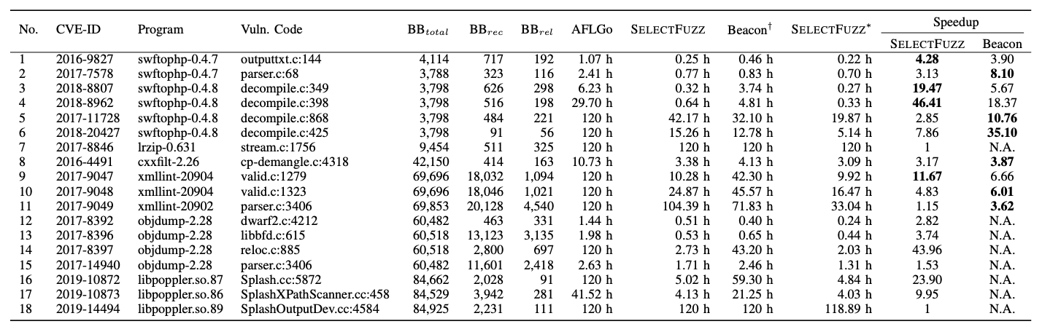
Evaluation: Triggering known vulnerabilities
Settings
Experiment 5 times
Time budget of 120 hours

Slide 107
Evaluation: Triggering known vulnerabilities
SelectFuzz
Success 16 out of 18
Failed 2 out of 18

Slide 108
Evaluation: Triggering known vulnerabilities
SelectFuzz
Success 16 out of 18
Failed 2 out of 18
Up to 46.41x speedup by selectfuzz

Slide 109
Evaluation: Triggering known vulnerabilities
AFLGo
Success 9 out of 18
Failed 9 out of 18

Slide 110
Evaluation: Triggering known vulnerabilities
Beacon
Not open source
Seed corpus

Slide 111
Evaluation: Triggering known vulnerabilities
Beacon
Not open source → Used binary in Docker image (Beacon+AFL)
Seed corpus

Slide 112
Evaluation: Triggering known vulnerabilities
Beacon
Not open source → Used binary in Docker image (Beacon+AFL)
Seed corpus → Unavailable

Slide 113
Evaluation: Triggering known vulnerabilities
Beacon
Not open source → Used binary in Docker image (Beacon+AFL)
Seed corpus → Unavailable
Reuse reported results

Slide 114
Evaluation: Triggering known vulnerabilities
Beacon
Not open source → Used binary in Docker image (Beacon+AFL)
Seed corpus → Unavailable
Reuse reported results
Could not compare Beacon+AFLGo

Slide 115
Evaluation: Triggering known vulnerabilities
Beacon
Better than Beacon in 4 out of 10 (even with no pruning)
Better in cases where SelectFuzz executed unreachable code

Slide 116
Evaluation: Triggering known vulnerabilities
Beacon
Path selection and path pruning could improve efficiency
SelectFuzz has less overhead

Slide 117
Evaluation: Triggering known vulnerabilities
Beacon + Selectfuzz
Outperformed Beacon* in all cases
5.23x speedup

Slide 118
Evaluation: Triggering known vulnerabilities
Path pruning and selective path exploration are complementary
Beacon + Selectfuzz
Outperformed Beacon* in all cases
5.23x speedup

Slide 119
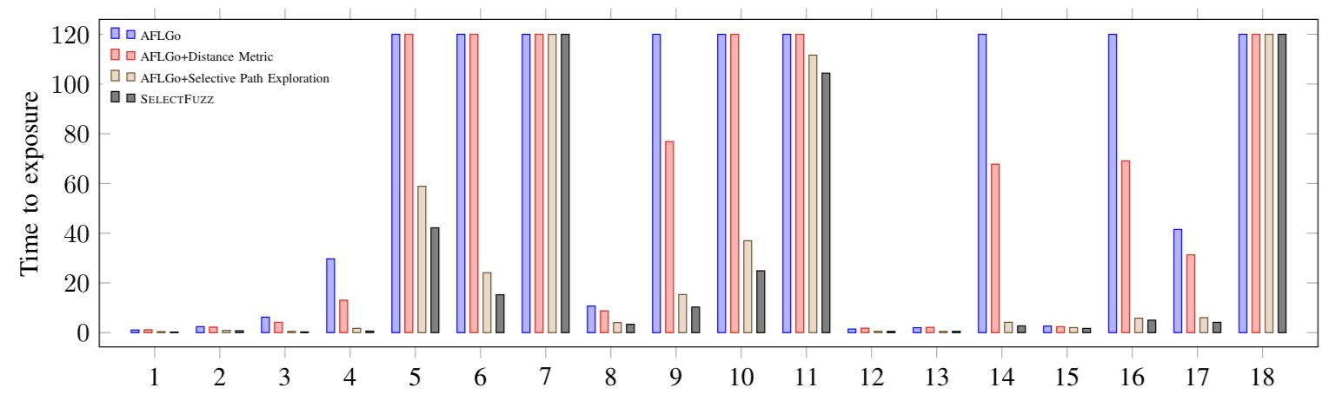
Evaluation: Ablation study
AFLGo+distance metric
Improved AFLGo by 39%

Slide 120
Evaluation: Ablation study
AFLGo+Selective path exploration with AFLGo distance metric
6.68x Speedup

Slide 121
Evaluation: Ablation study
AFLGo+Selective path exploration with AFLGo distance metric
6.68x Speedup
SelectFuzz outperformed it in 17 out of 18

Slide 122
Evaluation: Factors that affect performance
Introduces Instrumentation overhead
Identified 1.96% of BB or 12.33% of Reachable BB as relevant
Significantly less than AFLGo

Slide 123
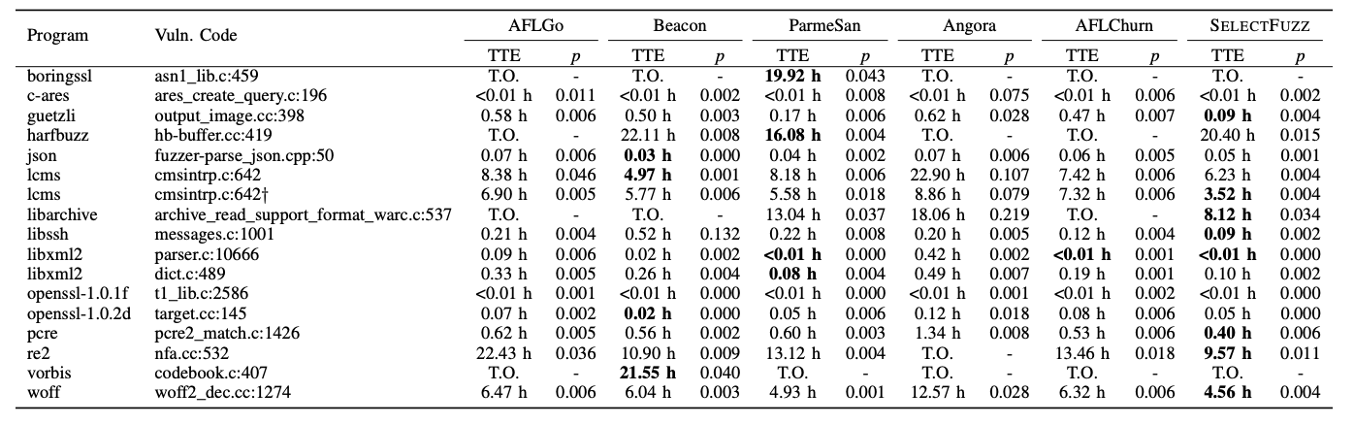
Evaluation: Performance on Benchmarks
Settings
On Google Fuzzer Test Suit (GFTS)
Assess different techniques (e.g path pruning, byte-level taint tracking, SPE)
5 times 24 hour budget

Slide 124
Evaluation: Performance on Benchmarks
SelectFuzz
Best at libarchive

Slide 125
Evaluation: Performance on Benchmarks
SelectFuzz
Best at libarchive → AFLGo, Beacon and AFLChun failed

Slide 126
Evaluation: Performance on Benchmarks
SelectFuzz
Best at libarchive → AFLGo, Beacon and AFLChun failed
Statistically significant results for most cases

Slide 127
Evaluation: Performance on Benchmarks
SelectFuzz
Best at libarchive → AFLGo, Beacon and AFLChun failed
Statistically significant results for most cases
Not so good at generating high quality constraints

Slide 128
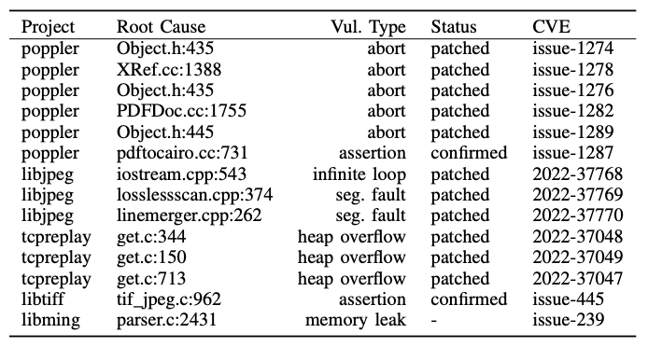
Evaluation: New vulnerabilities
Applications evaluated in recent works

Slide 129
Evaluation: New vulnerabilities
Applications evaluated in recent works
14 new vulnerabilities with a time budget of 72 hours

Slide 130
Evaluation: New vulnerabilities
Applications evaluated in recent works
14 new vulnerabilities with a time budget of 72 hours
Heap overflow, segmentation fault, memory leak

Slide 131
Evaluation: New vulnerabilities
Applications evaluated in recent works
14 new vulnerabilities with a time budget of 72 hours
Heap overflow, segmentation fault, memory leak
Complex software (e.g popple and libjpeg)

Slide 132

SelectFuzz
Limitations

Slide 133
Limitations: False positives
Overestimation of relevant code
Overapproximates call relationships
Conservative alias analysis in data-flow analysis
All variables are considered critical when identifying data-dependent code

Slide 134
Limitations: False positives
Overestimation of relevant code
Overapproximates call relationships
Conservative alias analysis in data-flow analysis
All variables are considered critical when identifying data-dependent code
Not solved

Slide 135
Limitations: False positives
Overestimation of relevant code
Overapproximates call relationships
Conservative alias analysis in data-flow analysis
All variables are considered critical when identifying data-dependent code
Not solved
Already excludes a large portion of the code

Slide 136
Limitations: False positives
Overestimation of relevant code
Overapproximates call relationships
Conservative alias analysis in data-flow analysis
All variables are considered critical when identifying data-dependent code
Not solved
Already excludes a large portion of the code
Static analysis techniques could help

Slide 137
Limitations: Complex path Constraints
Random mutation is not effective
Common challenge in fuzzing

Slide 138
Limitations: Complex path Constraints
Random mutation is not effective
Common challenge in fuzzing
Integrating techniques such as symbolic execution can help

Slide 139
Limitations: Identifying vulnerable paths
Attempts to explore all reachable paths
Common challenge in fuzzing

Slide 140
Limitations: Identifying vulnerable paths
Attempts to explore all reachable paths
Common challenge in fuzzing
Not all reachable paths are vulnerable

Slide 141
Limitations: Identifying vulnerable paths
Attempts to explore all reachable paths
Common challenge in fuzzing
Not all reachable paths are vulnerable
Including addition vulnerability information such as crash dump can help

Slide 142
Thank You

